Slide 1
Midpoint: MIDI music boxes
Wei-Wei Lu, Trevor Walker

Slide 2
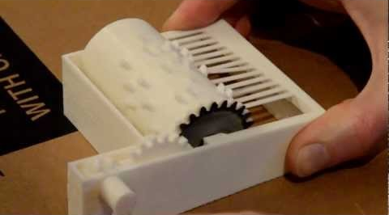
Project recap
3D printing custom music boxes
Interactive design based on MIDI
Improves on existing solutions
Easier to design
Better sound

Slide 3
Project components
3D-printable music box, without cylinder
MIDI parser producing OpenSCAD files for cylinder
Python script generating comb to correspond with cylinder
Web app for interactive generation of comb and cylinder from MIDI

Slide 4
Progress so far
Complete
In progress
Base music box
MIDI → cylinder conversion
Automatic comb generation
Web interface

Slide 5
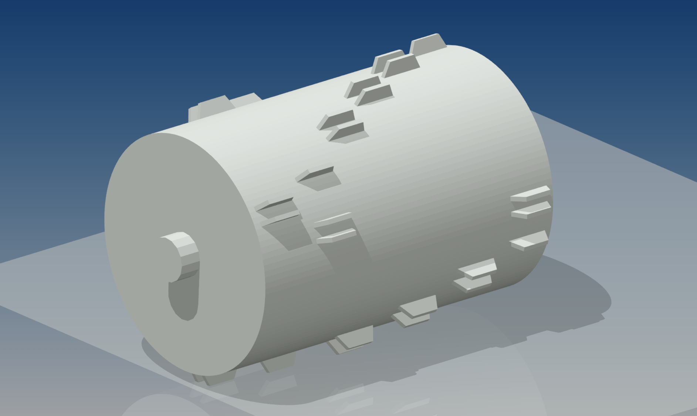
Example cylinder

Slide 6
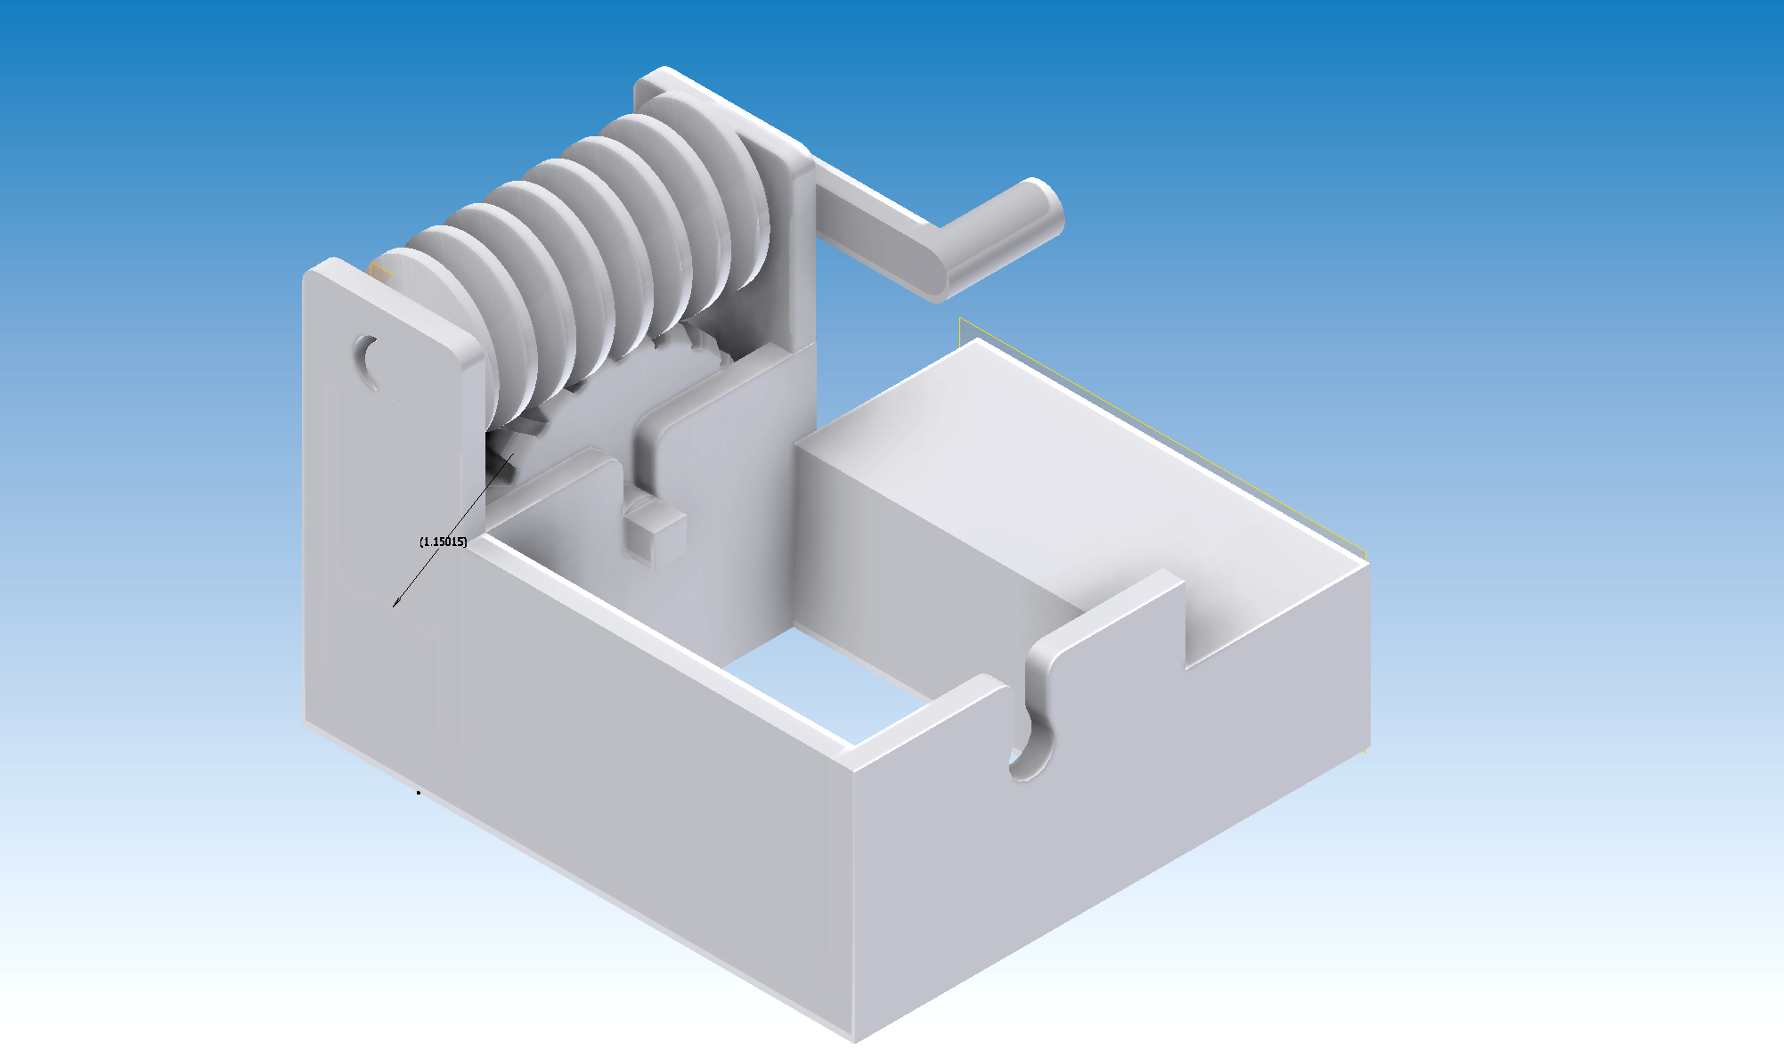
Music box frame

Slide 7
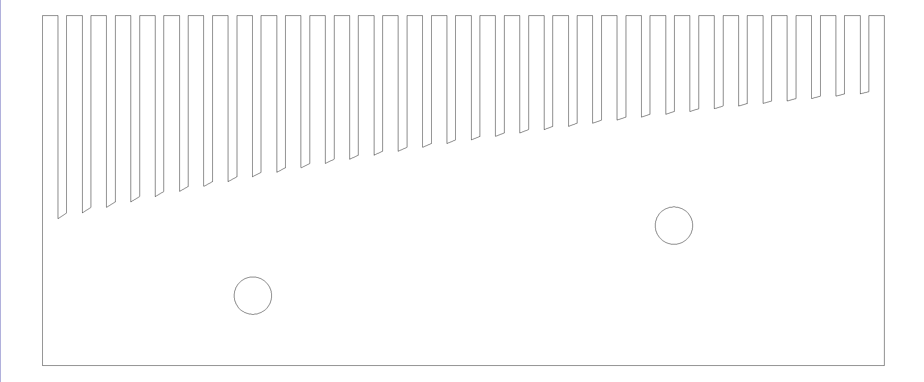
Example comb

Slide 8
What’s left
Finish web app
Prototype
Test whether fabricated design meets expectations
Iterate
Improve anything not up to spec

Slide 9
Questions?

